Slide 1
VAT Group Update
Charles Green

Slide 2
Why have a VAT group?
Formed in 2017 with the objective of producing easily accessible VAT information for members
Beginning with group members:
Czech Republic
Italy
Lithuania
Norway
Spain
UK

Slide 3
Where have we got to?
Group member schedules available in the members area of the website.
Username: chint / Password: global

Slide 4
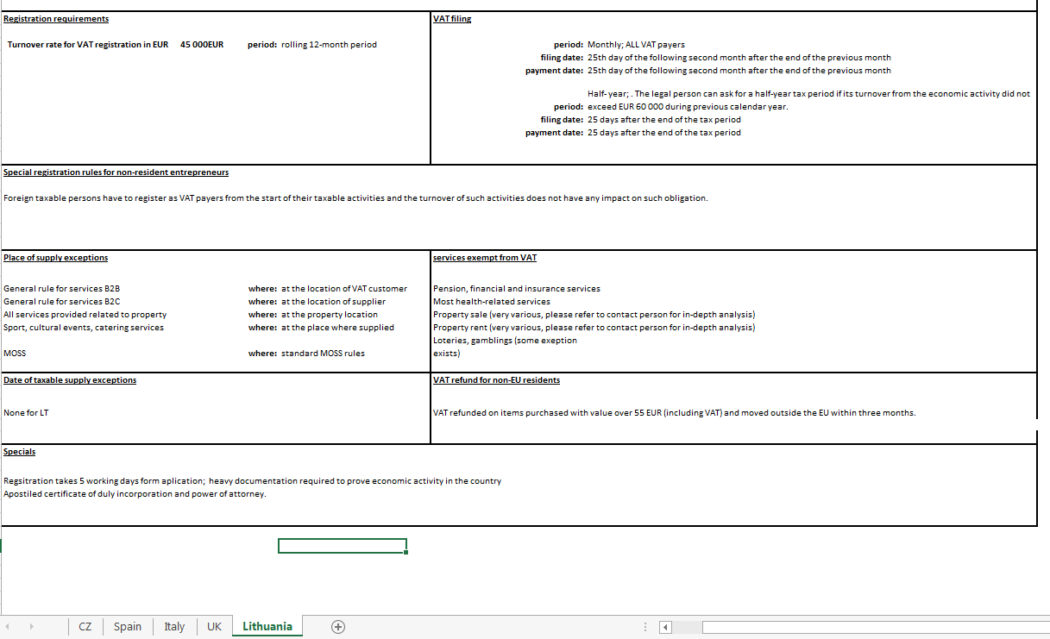

Slide 5
Next steps
Organise schedules into two categories: EU / Non-EU for full access in members’ area
PDF summaries for each member page of the website
A template will be shared for you to complete for your country

